Slide 1

SDS: Automation POC
June 2019 | Confidential

Slide 2
Agenda
1
POC Focus areas
2
Existing solution
3
Tested solution: DBaaS
4
Proposed and tested solution: Ansible
5
Summary

Slide 3

POC Focus Areas
CALM functionality overview
DBaaS automation
Integration with Ansible
Micro-segmentation

Slide 4
Current state
SDS offers 9 kinds of DBaaS (MariaDB, MySQL, Postgres, Postgres Enterprise, PPAS, MSSQL for RDS, Mongo, Elastic Search, ScyllaDB for NoSQL)
Provision automated with Ansible
End-user could request a DB via self-service portal (developed in-house)

Slide 5
Pain points
Hard to integrate with IaaS (ansible uses vcenter api for infra deployment)
Need to maintain multiple Ansible towers for each DB type
Network
Compute
Storage
No single point of integration between SSP and Ansible (need to run multiple playbooks)
Ansible codebase is hard to maintain

Slide 6
POC Requirements
SDS wants to maximize re-use of existing Ansible code base
Ansible/CALM integration required
SDS will slowly migrate Ansible to CALM
Ease of configuration / day-2 operations required
Integrated Network, Compute and Storage provisioning
Ease of integration with SSP
Automated scale-out functionality

Slide 7
SDS DBaaS architecture – current state
AZ01
AZ02
Network
User portal
Pre-defined network
DNS
REST API CALL
Computing
DB
(A : basic)
DB
(S : deployed with HA)
OS
Ansible
network
network
Pre script (DB runtime)
core
DB engine
DB engine
DB parameter
pacemaker
pacemaker
playbook
DB install
corosync
corosync
post script (DB env.)
DRBD
DRBD
replication
Storage
storage
storage
Size from pre-configured datastore

Slide 8
Tested solution: DBaaS
User porta (not in a l
Node 1 (Future: Zone 1)
Node 2 (Future: Zone2 )
DNS
REST API CALL
DB
(Primary)
DB
(Secondary)
CALM blueprint
Network
Computing
network
network
Pre-defined network
OS
DB engine
DB engine
Pre script (DB runtime)
pacemaker
pacemaker
Corosync
Corosync
DB parameter
DRBD
DRBD
DB install
replication
Storage
1 volume per VM
post script (DB env.)
storage
storage

Slide 9
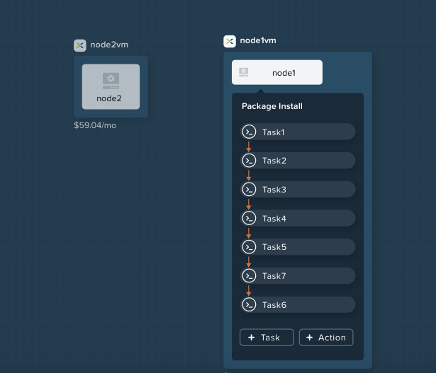
Tested solution: DBaaS
Blueprint will deploy 2 VMs and configure MYSQL/DRBD/Virtual IP
Challenges that we had:
There are dependent tasks on VM1/VM2, so we had to put “idle” tasks
Requesting/release of a virtual IP address require custom Escript
Disable SELinux!

Slide 10
Workflow: DBaaS
User portal
REST API CALL
CALM Provision
Ansible
Network
Configuration
Pre-defined network
Pre script (DB runtime)
CALM blueprint
Computing
REST API CALL
DB parameter
OS
DB install
Storage
post script (DB env.)

Slide 11
Q&A session highlights
Q: Do you support Disk UUID display? It is necessary to configure cluster SW? A: Yes. We can use disk uuid without any config unlike VMware. (showed at demo)
Q: Do you support Job schedule? A: Yes. With X-play you can add job to VM or VM group. Recursive option will be add at next version.
Q: Can we check the progress of Ansible job status on Calm audit? A: Yes. You can see the progress log and status on Calm by inserting a checking task. (Showed at demo)
Q: Can we reuse Calm task? A: Yes. You can register a every task to library and can import to any blue print.
Q: Can we check all parameter (static/runtime) we input ? A: Yes, You can see every parameter used in application provisioning. (GUI / CLI)
Q: Do you support auto scaling ? A: We can implement it with X-play or OSS integration. You proved it at 1st PoC already. Native auto scaling is coming by end of this year.
Q: Can you provide source code mgmt. feature like git. for Calm ? A: Not, Yet. It will come with next version (2019Q3)
Q: Do you support the scheduling based-on over subscription ratio? A: No. Our resource scheduling is based-on utilization and affinity rules. But if you are using your own portal, you can implement that using Prism API.

Slide 12
POC result summary
MySQL cluster deployment – done in 15 minutes with CALM VS 45 minutes with Ansible
Ansible integration – we have demonstrated 2 ways of integration : CALM-to-Ansible and Ansible-to-CALM
SDS determines that there is no problem in linking the existing service to Calm and was very satisfied with our solution and support.
SDS said “well done and thank very much”.
Sold 9-node all flash cluster for Cloud pilot. (Calm, Flow, Files)

Slide 13
Thank you

